Slide 1
MQS duplicate data: impact on BICoE
Five duplicate scenarios, what they do to Silver and Gold, and why the DVLA retention pipeline is failing
8 October 2026
Notes:
Purpose: explain to a wider audience why duplicate MQS quote records exist in BICoE, what they affect downstream, and what we need to resolve it. Detail is in the technical review document.

Slide 2



Three things to know
3×
DVLA
OK
Duplicates reach Silver and Gold
Retention pipeline is failing
Reconciliation is not impacted
Three of five scenarios reach Gold. One sample quote, resent on two later days, now appears three times.
Exact duplicates (same timestamp) stop DVLA (Driver and Vehicle Licensing) data being removed: a compliance risk.
Reconciliation applies its own duplicate handling and is unaffected by all five scenarios.
Notes:
The headline: some duplicates get all the way to Gold, and duplicates are breaking the DVLA retention pipeline, which is a compliance control. Reconciliation is fine.

Slide 3
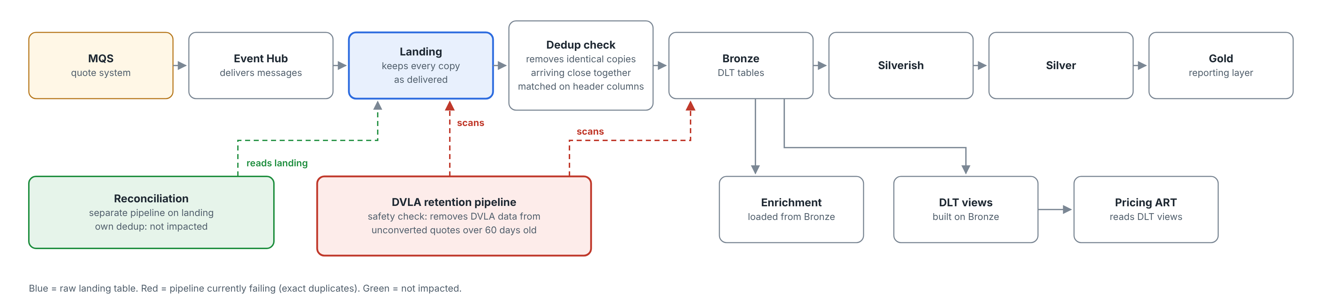
Every copy lands; our dedup only filters on the way to Bronze
Every copy lands
Dedup is narrow
Separate pipelines on landing
MQS data is ingested as delivered; the landing table keeps every repeat copy.
It only removes identical copies (matched on header columns) arriving close together. Anything else flows on to Bronze, Silver and Gold.
DVLA retention scans landing and Bronze. Reconciliation has its own dedup and is not impacted.
Notes:
Key point for the audience: dedup is not a general duplicate filter. It only catches identical copies that arrive close together. From Bronze (DLT tables) the enrichment tables are loaded and the DLT views are built; Pricing ART reads the DLT views. Reconciliation is a separate pipeline on landing with its own dedup. The DVLA retention pipeline is a separate safety check that scans landing and Bronze, and landing still holds every copy.

Slide 4
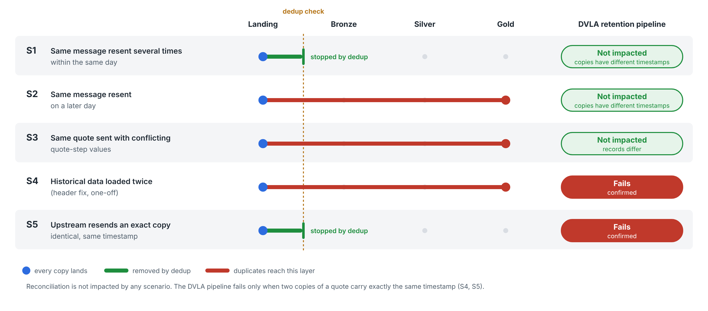
Five duplicate scenarios: dedup stops only two
Notes:
S1 same message resent several times on the same day: stopped by dedup. S2 same message resent on a later day: reaches Gold (confirmed in sample). S3 same quote with conflicting quote-step values, an MQS defect seen again 8-30 Sep 2026: reaches Gold. S4 historical data loaded twice during the header fix, one-off: reaches Gold, including enrichment. S5 upstream resends an exact copy: stopped by dedup when copies arrive close together. DVLA: fails for S4 and S5 (copies with exactly the same timestamp); S1, S2 and S3 do not affect it.

Slide 5
One quote resent on later days became three rows in Gold
22 Sep
23 Sep
25 Sep
Other Silver and Gold impacts
Quote first sent
Resent (02:00 UTC)
Resent (02:00 UTC)
S3: conflicting versions of one quote in Silver and Gold; unclear which is correct
S4: historical duplicates in Silver, Gold and enrichment for the backfill period
Pricing ART reads the DLT views built on Bronze; S2, S3 and S4 duplicates expected there (being checked)
3 rows in Silver, 3 rows in Gold
Same quote, same business content, one row per day it arrived. Any report counting quotes by date counts it three times.
Confirmed in a production sample (quote MQS-59908abc…), traced from Landing to Gold
Notes:
This is scenario 2. Dedup removed a same-day copy, but the later resends passed straight through to Gold. The resends arrive at about 02:00 UTC, which points to a scheduled upstream process; MQS to confirm.

Slide 6
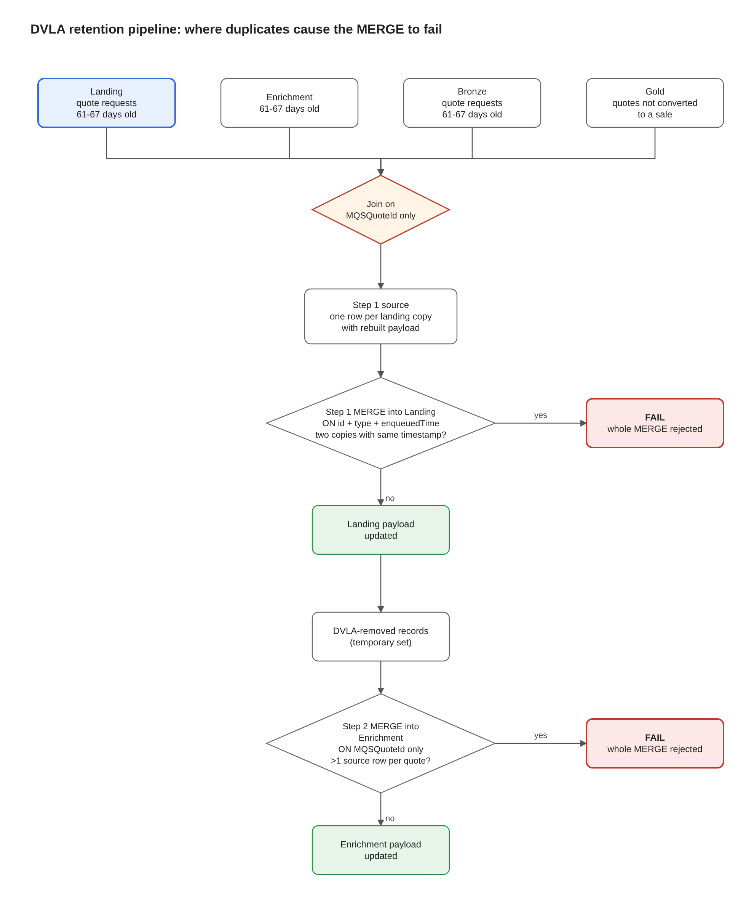
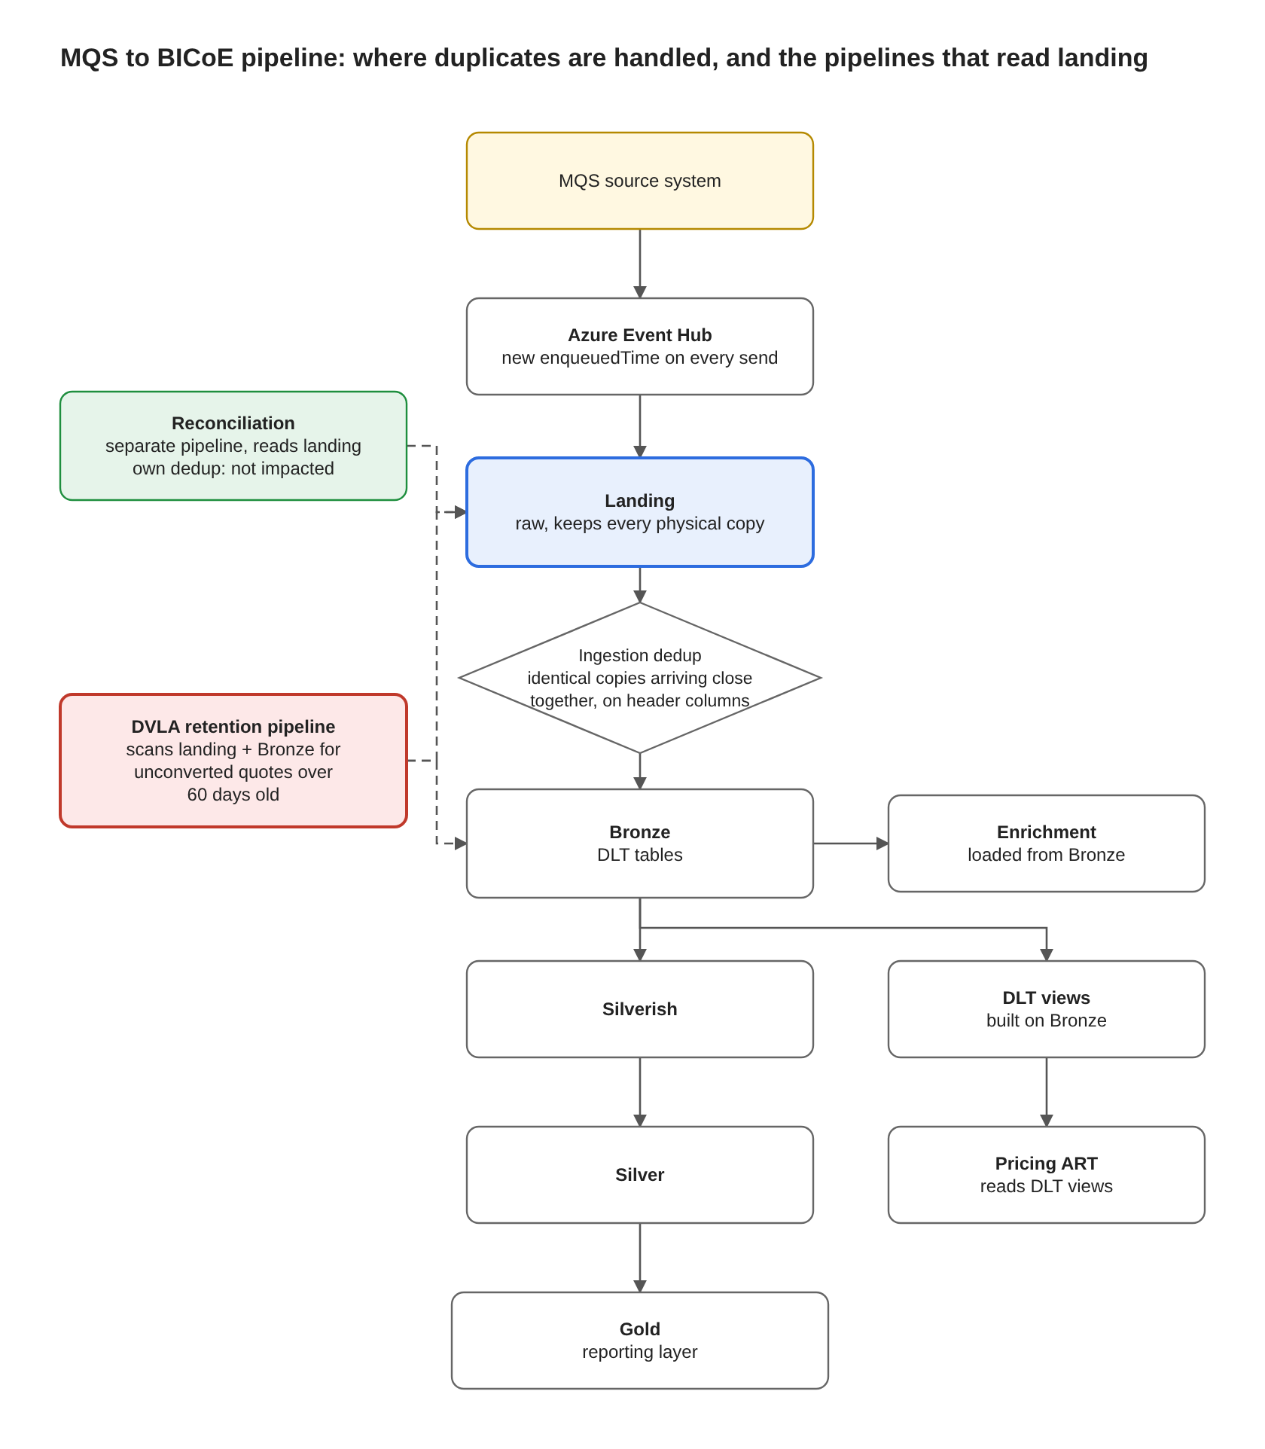
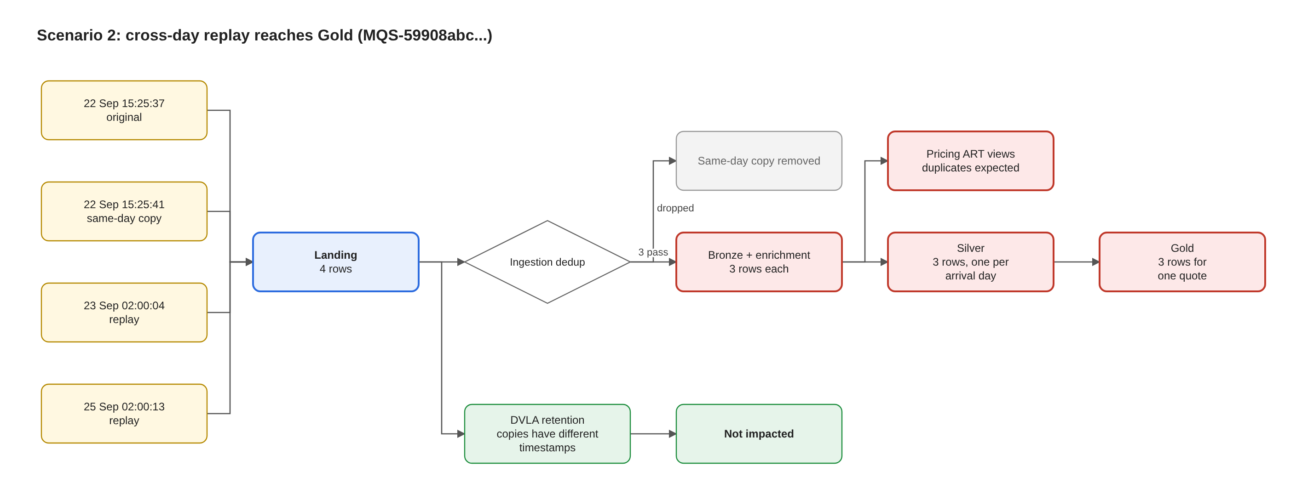
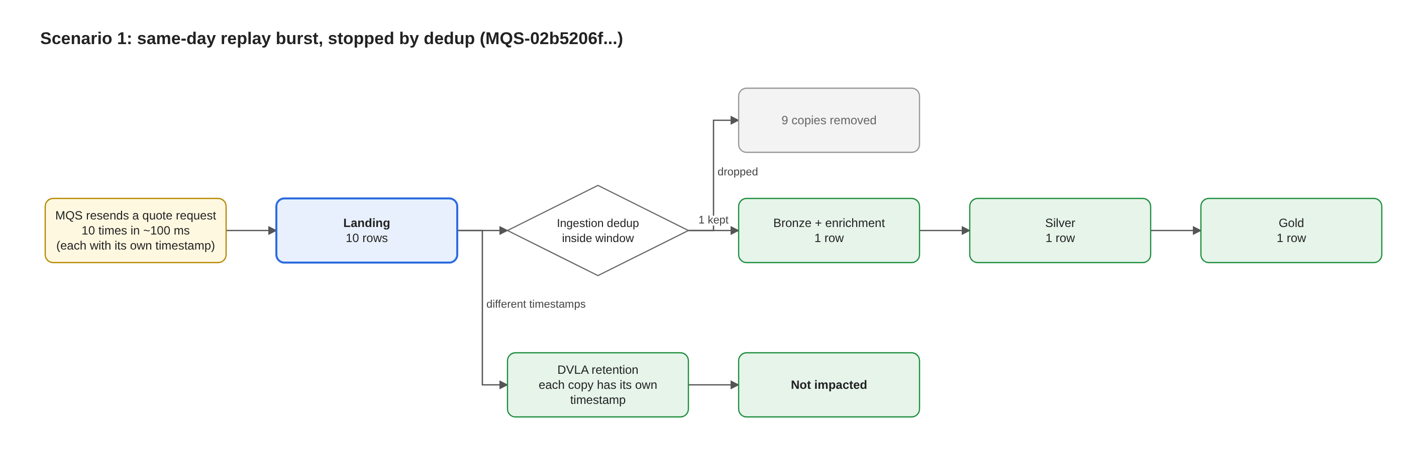
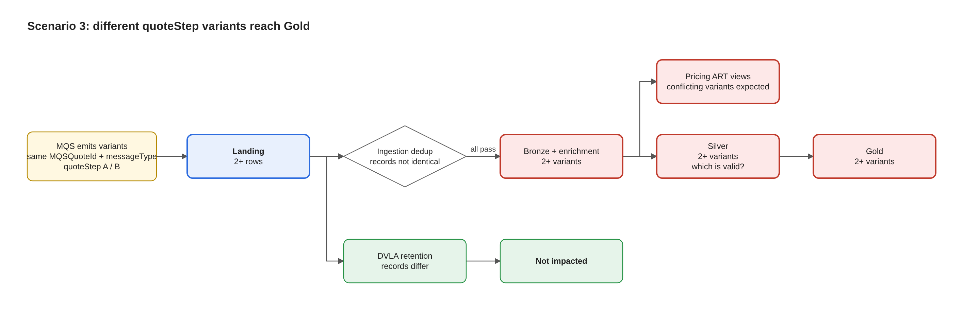
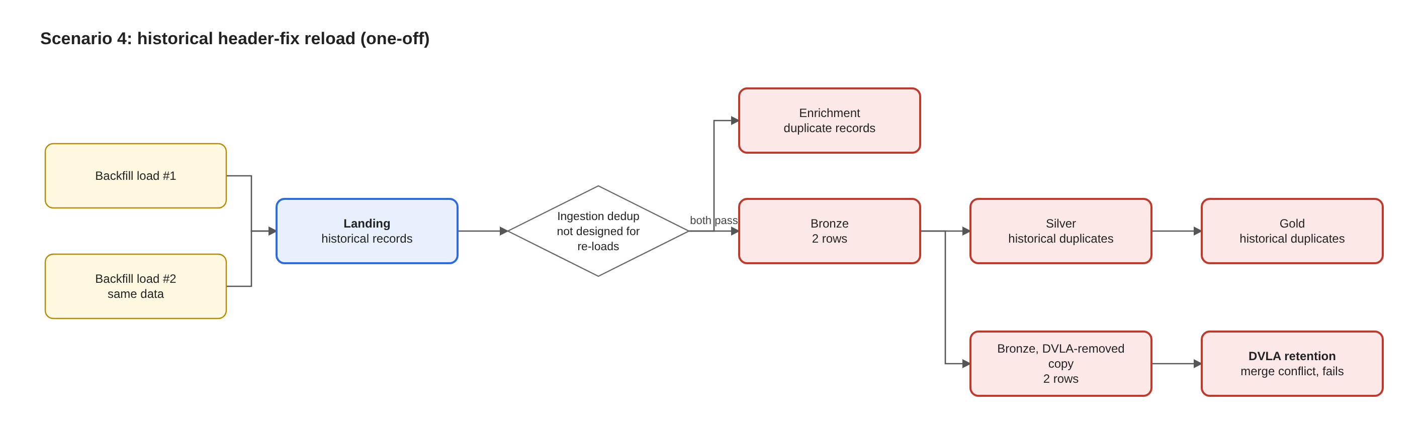
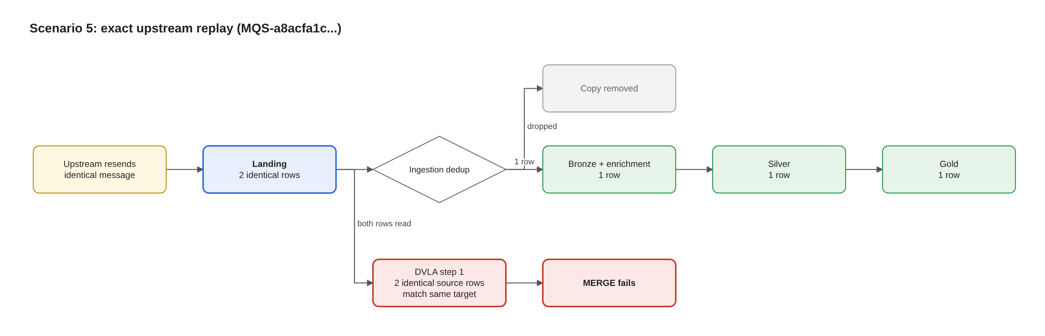
Notes:
This is scenario 2. Dedup removed a same-day copy, but the later resends passed straight through to Gold. The resends arrive at about 02:00 UTC, which points to a scheduled upstream process; MQS to confirm.

Slide 7
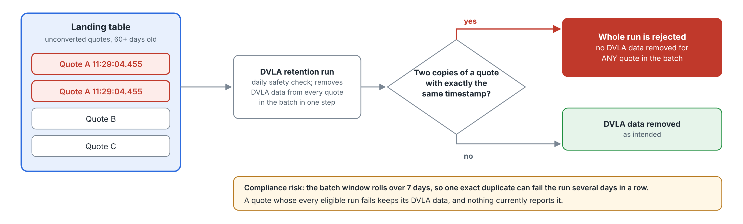
The DVLA retention pipeline is failing: a compliance issue
A separate safety check: it scans landing and Bronze for unconverted quotes over 60 days old still holding DVLA data. Landing still holds every copy. If two copies of a quote carry exactly the same timestamp, the whole daily run is rejected.
Fails for S4 (historical reload) and S5 (exact resends). Not impacted by S1, S2 and S3: their copies have different timestamps or content.
Notes:
S5 breaks it even though dedup removes the copy before Bronze, because the pipeline reads landing, where the identical copy remains. Copies with different timestamps (S1, S2, S3) are handled. One exact duplicate blocks the whole batch, can fail the run several days in a row, and a quote whose every eligible run fails keeps its DVLA data with nothing reporting it.

Slide 8
Good news: reconciliation is not impacted
Where we stand on each impact
Impact | Status
S2, S3 and S4 duplicates reach Gold | Confirmed
DVLA pipeline fails (S4, S5) | Confirmed
DVLA pipeline (S1, S2, S3) | Not impacted
Pricing ART views show duplicates | Being checked
Reconciliation | Not impacted
Reconciliation applies its own duplicate handling and is unaffected by all five scenarios.
Confirmed = seen in production data or confirmed by the team. Being checked = from analysis, not yet reproduced.
Notes:
Reconciliation is safe. Be clear about what is confirmed versus still being checked so nobody over- or under-reads the impact.

Slide 9
What we need from you
Ask | Owner | Why
Prioritise restoring the DVLA retention pipeline, including a catch-up of the days it has failed | Leadership + BICoE | Compliance
Explain why messages are resent, including resends at about 02:00 UTC each day | MQS | Root cause of S1, S2, S5
Confirm which quote-step value is correct when versions conflict | MQS | Needed before S3 clean-up
Agree what makes “one quote event” unique | MQS + BICoE Architecture | Basis for a permanent fix
Size the S2, S3 and S4 duplicates already in Gold | Glenn / Gold owner | Plan the Gold clean-up
Confirm whether Pricing ART views show duplicates | Pricing ART | Close consumer impact
Confirm which DVLA runs failed and which quotes were in them | DVLA owner | Size the compliance gap
Notes:
Close on the asks. The DVLA restoration is the priority because it is a compliance control. The detailed technical review document has per-scenario evidence for anyone who wants it.

Slide 10
Notes:
Close on the asks. The DVLA restoration is the priority because it is a compliance control. The detailed technical review document has per-scenario evidence for anyone who wants it.

